Slide 1

Harbor Area Treatment Scheme - 2A
Harbor Area Treatment Scheme – 2A
--- Lecturer: Terry Chan.Project Manager

Slide 2
Main Content
Project Background
Construction Approaches
Major Risks
Site Geology
Current Progress

Slide 3
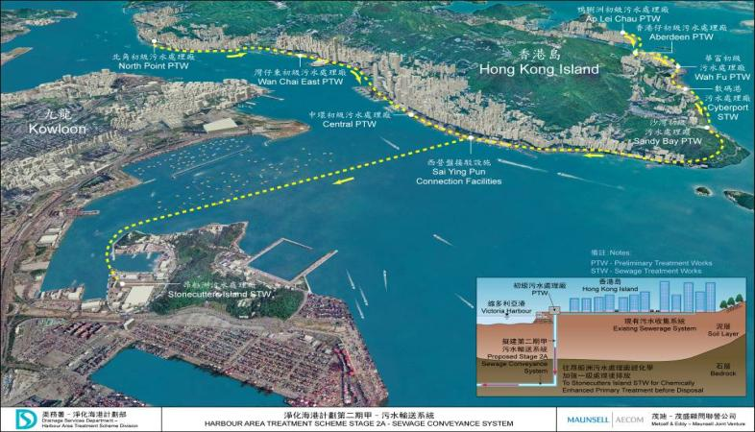
Background
Project Background
Project commenced at 31 July 2009
Project complete on end of 2015
8 working sites from North Point to Stonecutter Island
Construction of three deep tunnels up to 165m in depth
Totally 12 km in length drill and blast techniques
Construction of 8 shafts for both production and drop shafts
Contract Sum: 3.6 billions

Slide 4
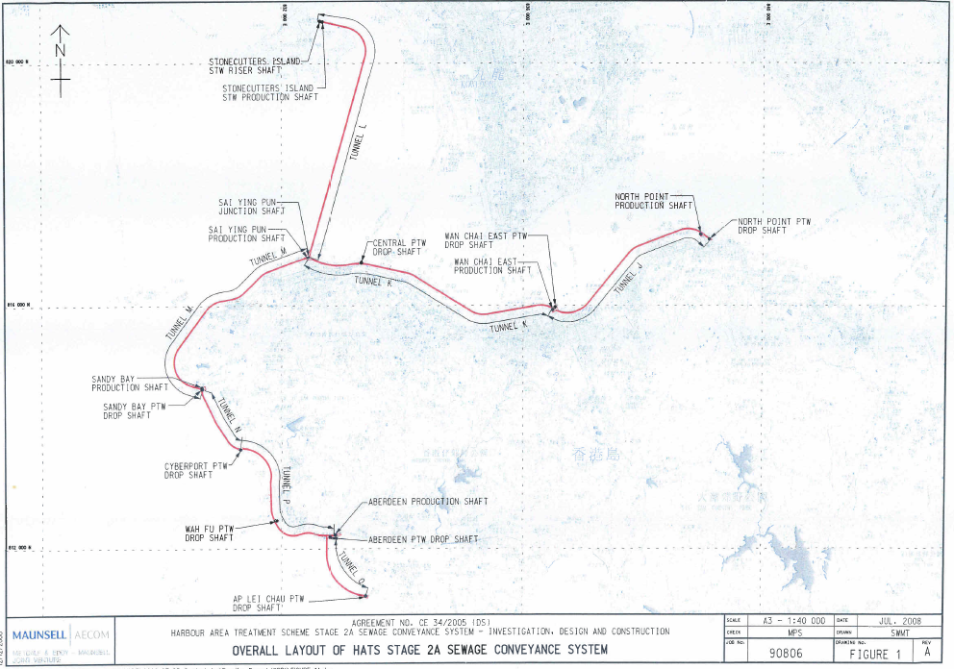
Background
Legend: Drop Shaft
Production Shaft
Junction Shaft
Riser Shaft

Slide 5
Construction Approaches
zzzzzzzzz
Methodology
Shaft Construction
Tunnel Construction
Mucking Out System
Mechanical Excavation (Soil Layer)
Drill & Blast with grouting (Rock Layer)
Excavation Lateral Support (ELS):
8 Reinforced Concrete Panels
Diaphragm Walls
Drilling
Charging/Blasting
Mucking/Scaling
Temporary Support
Grouting
Hagg Loader
Load Car/Railway
Mucking Skip
Headframe

Slide 6
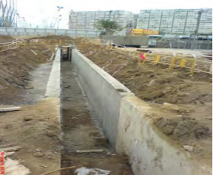
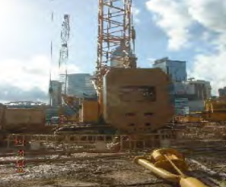
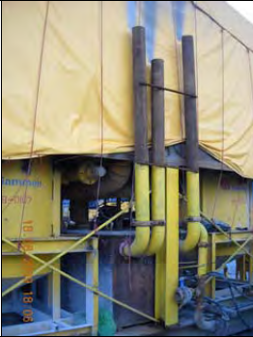
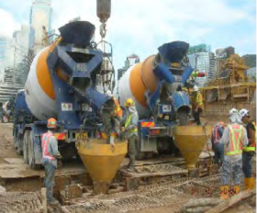
Shaft Construction
Construction of
Guide Wall
1
Excavation by
Cable Grab
2
Preparation of
Bentonite
3
4
Concreting

Slide 7
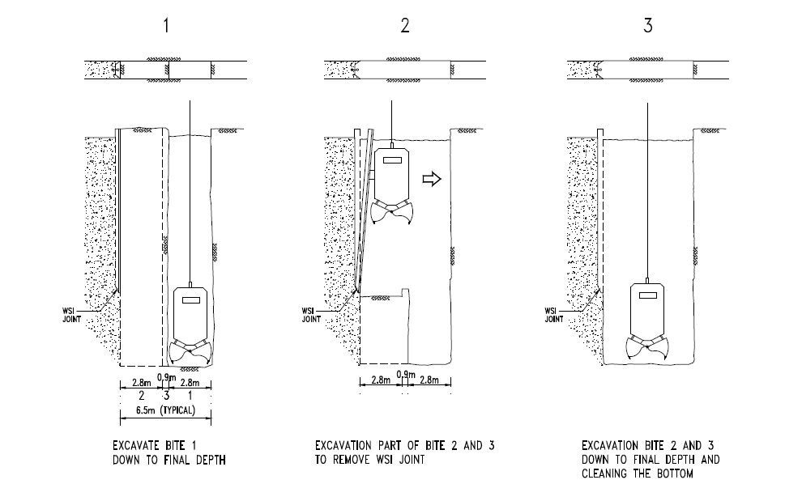
Shaft Construction
Construction of
Guide Wall

Slide 8
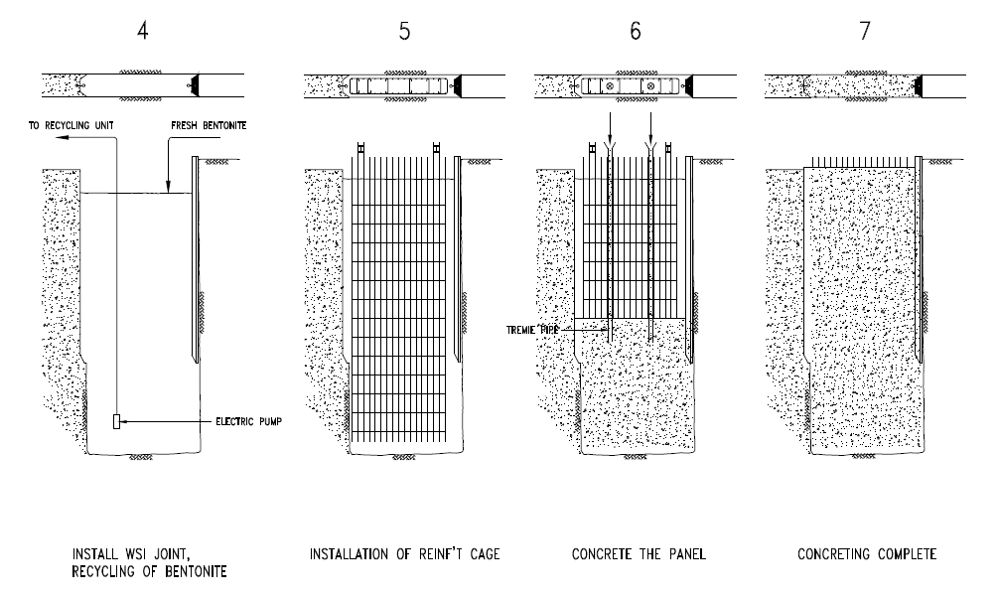
Shaft Construction
Construction of
Guide Wall

Slide 9
Shaft Construction
Construction of
Guide Wall
Head Sheave
Winder Driver’s Cabin
Head frame
Power k
Collar
Kibble
Winder
FSD Ladder way
Fixed Guide
for Cross Head
Shaft Bunton
FSD
Ladder way
Rope
Attachments
Skip
Shaft Bottom

Slide 10
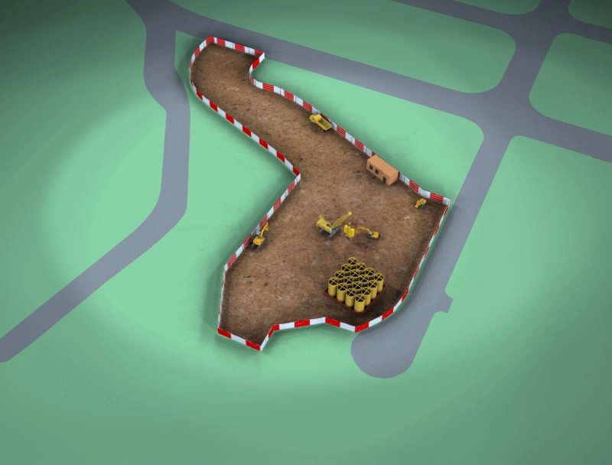
Shaft Construction
Construction of
Guide Wall

Slide 11
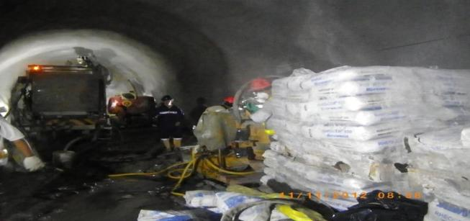
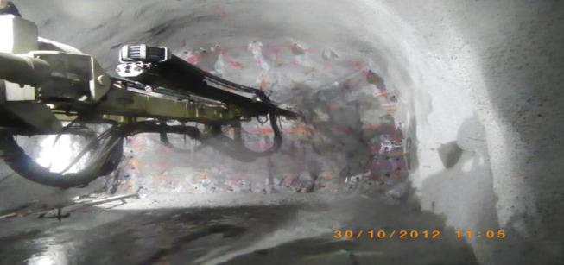
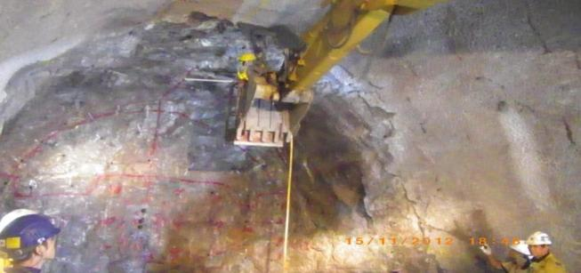
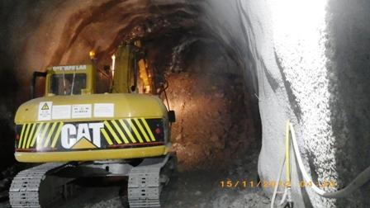
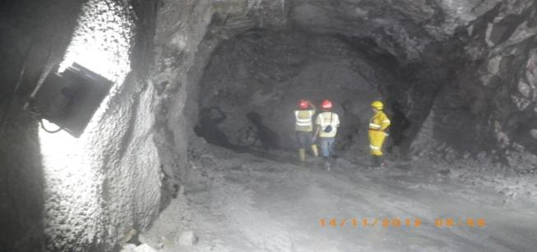



Tunnel Construction
Charging
Blasting
Mucking Out
Scaling
Drilling
Mapping
Tem Support
Grouting

Slide 12

Tunnel Construction

Slide 13
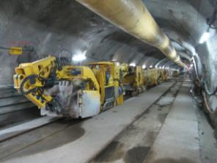
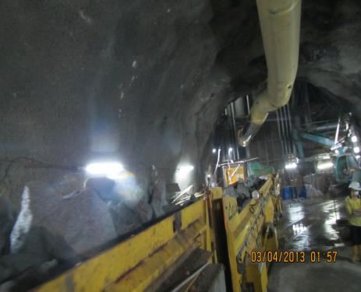
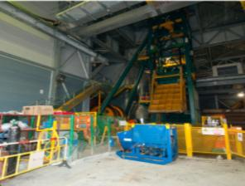
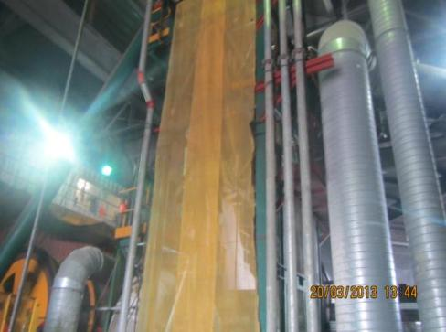
Mucking Out System
1
Hagg Loader
Shuttle Car / Railway
2
Mucking Skip
3
4
Headframe

Slide 14
Mucking Out System

Slide 15
Major Risks and Mitigations
Water Ingress and Mitigations
Major Risks and Mitigations
Rock Fall Hazard and Mitigations
Fire and Mitigations

Slide 16
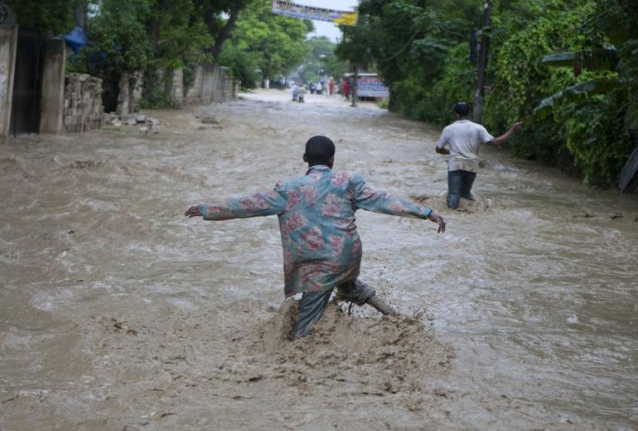
Water Ingress and Mitigations
Could we work under situation like this? Absolutely No!

Slide 17
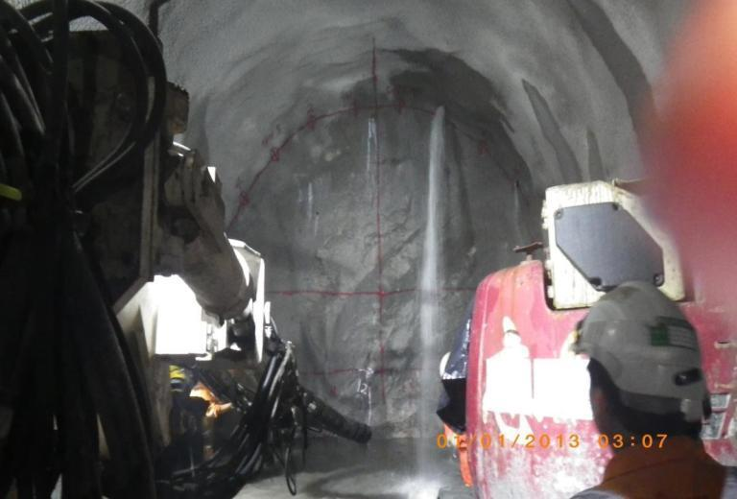
Water Ingress and Mitigations
It happened on the first day of the year 2013. What a nightmare began!

Slide 18
Water Ingress and Mitigations
Concept of Pre-Excavation Grouting
To maintain the residual inflow within the requirements
To eliminate the risks of any accidental inflow into the tunnel
To avoid excessive settlement of nearby structures
(Monitored by the GEOMON)
To increase the strength to the rock mass and control overbreak (according to Barton’s of pre-grouting for stability)

Slide 19
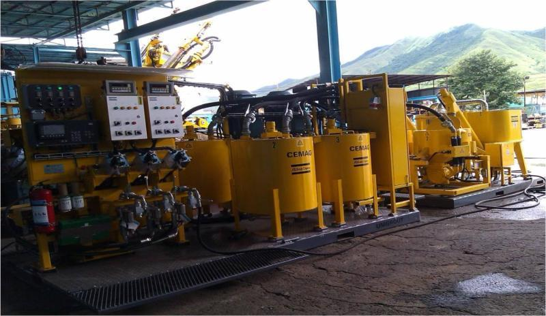
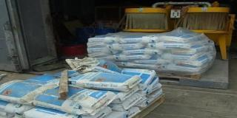
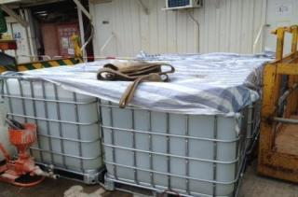
Water Ingress and Mitigations
Microfine Cement and its admixtures (for inflow >3L/min)
Colloidal Silica and Accelerator (for inflow <=3L/min)
Grouting Materials

Slide 20
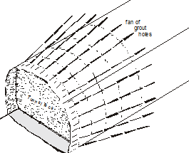
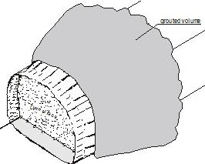
Water Ingress and Mitigations
Construction of Grouts Fan
After Drilling of Grout Holes
After Grouting of Grout Holes

Slide 21

Rock Fall Hazard and Mitigations
Rock Fall Hazard and Mitigations

Slide 22
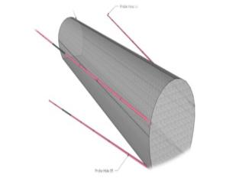
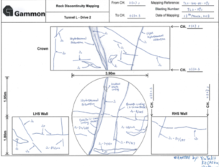
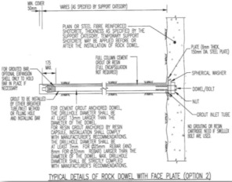
Rock Fall Hazard and Mitigations
Probing
Engineering Geological Mapping
Three Tackles in Tunneling Models
Temporary Supports

Slide 23
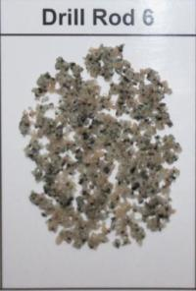
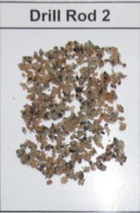
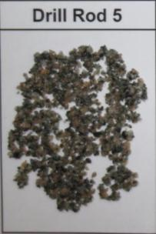
Rock Fall Hazard and Mitigations
Excavation Sections ahead(approx. 16 – 24m)
Collection of rock chips
Probing
Grade I
Fresh GRANITE chips
Grade I-II
Fresh Rock to Slightly Decomposed GRANITE chips
QUARTZPHYRIC RHYOLITE
with chloritized Granite

Slide 24
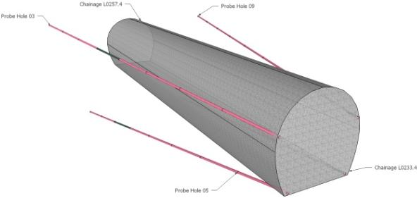








Rock Fall Hazard and Mitigations
Conditions of Rock Chips
Colour of back-flush Water
Analysis of All Observations
Probe Hole No.3

Slide 25
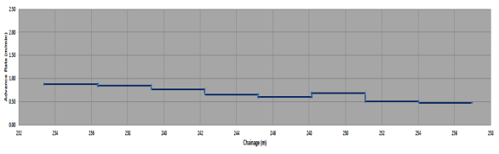
Rock Fall Hazard and Mitigations
Analysis of All Observations
Advance Rate
Possible Interpretation for Variation
Closely-jointed rock mass
- Deterioration of Strength of rock mass
Pocket void

Slide 26
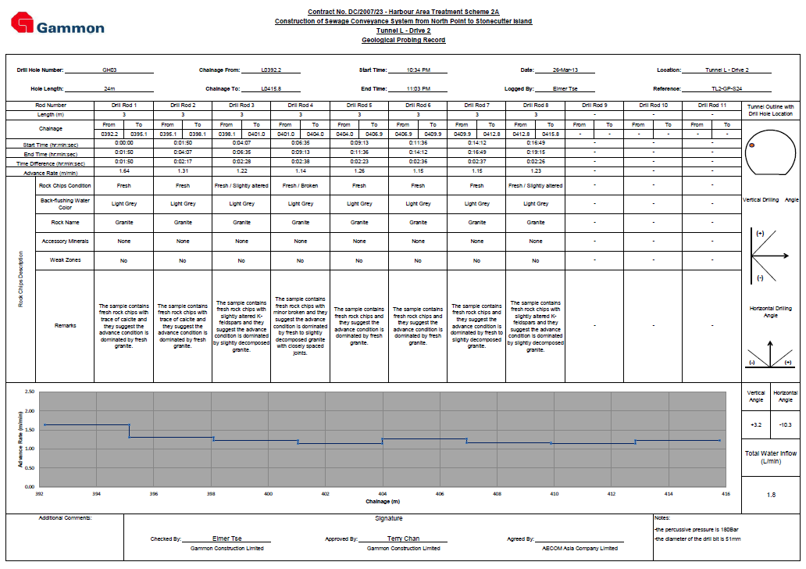
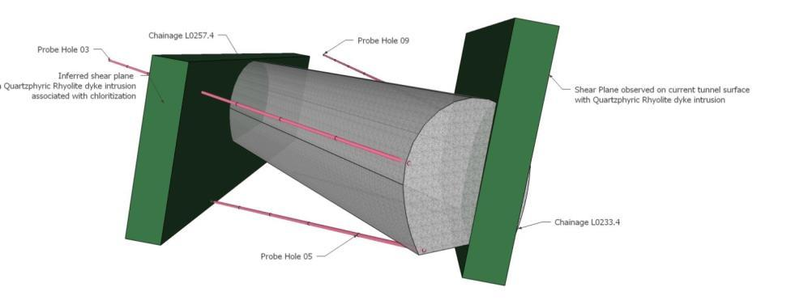
Rock Fall Hazard and Mitigations
A projected excavation section with expected major discontinuities will be plotted

Slide 27
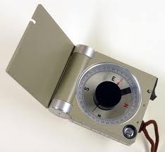
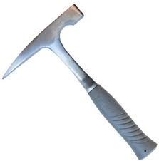
Rock Fall Hazard and Mitigations
Carried out by Geologists after every blast
Geological Mapping

Slide 28
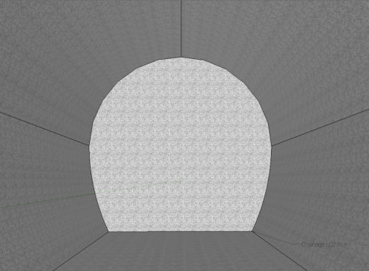
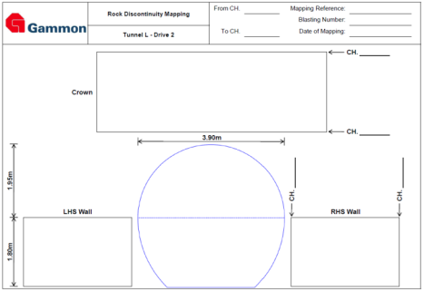
Rock Fall Hazard and Mitigations
Geological Mapping
Geological Mapping
Record for all geological features
Crown
Tunnel Front Face
Left
Sidewall
Right
Sidewall

Slide 29
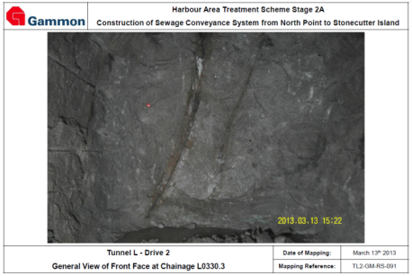
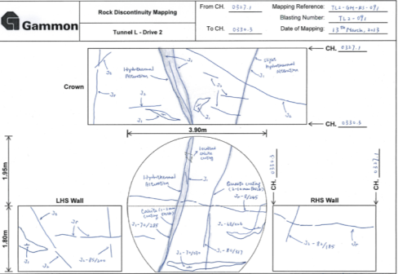
Rock Fall Hazard and Mitigations
Geological Mapping
with on-site Dip/Dip Direction measurements
On-scale mark-ups

Slide 30

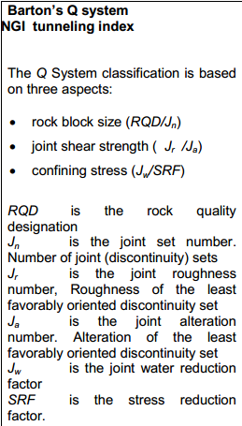
Rock Fall Hazard and Mitigations
Features Observed | Factors Considered
- Infilling, e.g. calcite, quartz, chlorite, kaolin (Ja) Joints Sets (Jn) Condition of rock quality (Rock Quality Designation - RQD) Joint Roughness (Jr) Water Ingress (Jw) Weak Zone (Stress Reduction Factors) Special Features (marked) - Xenolith, Flaking, Grout on joint surface
Observations VS Q-system

Slide 31
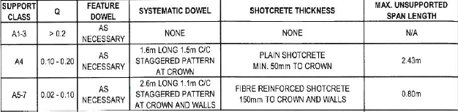
Rock Fall Hazard and Mitigations
Rock Dowels
Shotcreting
Temporary Supports
N.B Referring to support class drawings, Q value adopted in mapping will be used for execution of types of supports

Slide 32
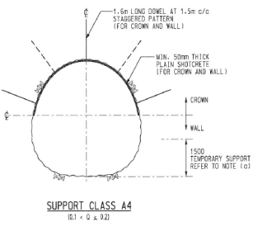
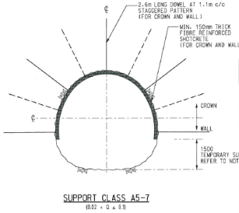
Rock Fall Hazard and Mitigations
Feature Dowels
Systematic Dowels
(with specific spacing and patterns)
Rock Dowels

Slide 33
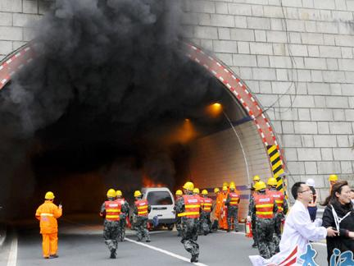
Fire and Mitigations
Fire and Mitigations

Slide 34
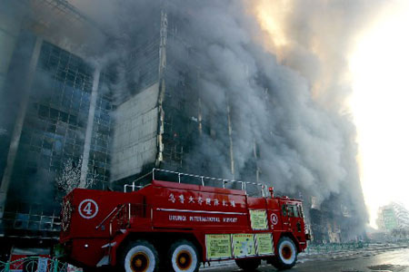
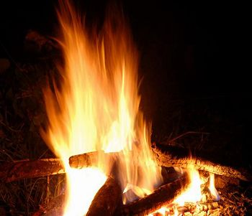
Fire and Mitigations
Smoke
Heat
Two Major Risks

Slide 35
Fire and Mitigations
Bridgehead at every 450m intervals
Precautions
Low Smoke Cable
Extinguisher
Fire hose reel
Self Rescuer

Slide 36
Fire and Mitigations
Every 450m in the tunnel will have one FSD bridgehead
  This is the exhausted point of smoke
Inside the FSD bridgehead we have
  Fire Extinguisher
  Direct Telephone System
  Breathing Apparatus
  CCTV
  Thermal Imaging Camera
  Manual Alarm
  Personnel Tracking System
  Sprinkler
Bridgehead

Slide 37
Fire and Mitigations
Bridgehead
FSD Bridge
Line phone
Alarm button

Slide 38
Fire and Mitigations
Low Smoke Cable
  LSZH sheath (Low Smoke Zero Halogen)
  Emitting non-toxic levels of poisonous halogen gases when it is melted

Slide 39
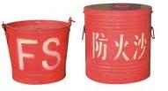
Fire and Mitigations
Electric distribution box | 2 X 2kg powder
Locomotive diesel inlet | 2 X 9L foam
Prominent position on each item of tunnel plant | 1 set
Every 90m inside tunnel | 1 set
At adit/ tunnel junction | 1 set
Within 50m of tunnel face | 6 buckets of dry sand
Extinguisher

Slide 40
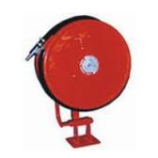

Fire and Mitigations
  Fire hose reel will be provided
  along the tunnel at 90m intervals.
  Each fire hose reel will have max
  50m length hose which provides a
  jet of water for extinguish fire by
  tunnel worker.
Fire Hose Reel

Slide 41




Fire and Mitigations
Self-rescuers will be stored inside the shaft area for emergency use
Self Rescuer

Slide 42
Site Geology
General Geological Background
Geological Profile
Site Geology
Rock Samples
Structures
Typical Geological Features

Slide 43

Site Geology
Geological Cross Section – Sai Ying Pun Junction Shaft
Approximate Rockhead Level based on Ground Investigation

Slide 44

Site Geology
Geological Profile – Tunnel K-Drive 3
Sai Ying Pun
Junction Shaft
Wan Chai
Inferred Rockhead Level based on Horizontal Directional Drilling (H.D.D.)
Central Drop Shaft
Rockhead level varied between -40mPD to -90mPD

Slide 45

Site Geology
Geological Profile – Tunnel K-Drive 3
Wan Chai
Central Drop Shaft
Inferred Rockhead Level based on Horizontal Directional Drilling (H.D.D.)
Horizontal Directional Drilling (H.D.D.)

Slide 46

Site Geology
Geological Profile – Tunnel L-Drive 2
Stonecutter Island
Sai Ying Pun
Junction Shaft
Inferred Rockhead Level based on Horizontal Directional Drilling (H.D.D.)
Horizontal Directional Drilling (H.D.D.)

Slide 47

Site Geology
Geological Profile – Tunnel L-Drive 2
Inferred Rockhead Level based on Horizontal Directional Drilling (H.D.D.)
Stonecutter Island
Sai Ying Pun
Horizontal Directional Drilling (H.D.D.)
Rockhead level decrease possibly due to zone of deep weathering related with faults

Slide 48

Site Geology
Structures
Sulphur Channel Fault
Minor Faults
(NE-Striking)
Sandy Bay Fault
Major Faults in Sai Ying Pun
Notes:
Zone of Deep Weathering could occur along the major faults and minor faults.

Slide 49




Site Geology
Structures
Slickenside
Grade III Granite affected by Brecciation
Sandy Bay Fault in Sai Ying Pun
Notes:
Zone of Deep Weathering could occur along the major faults and minor faults.

Slide 50

Site Geology
Hydrogeological Implications of Faults
High Groundwater Inflow can occur ANYWHERE and ANYTIME!
Notes:
Faults may act as conduits for preferential groundwater flow and capable of bearing large amount of water.
Major faults zones are generally deeply weathered and overlain by thick zone of saprolite, if large amount of groundwater is drawn down, significant settlement may occur

Slide 51

Site Geology
Rock Samples
Very strong to strong, light pinkish grey spotted with black, equigranular, crystalline, fresh medium to coarse-grained GRANITE

Slide 52

Site Geology
Rock Samples
Strong to moderately strong, light pinkish grey dappled with brown, equigranular, moderately decomposed medium to coarse-grained GRANITE

Slide 53

Site Geology
Rock Samples
Quartz veins
Strong to moderately strong, dark brownish grey, porphyritic, slightly to moderately decomposed CRUSH BRECCIA recemented with quartz veins

Slide 54

Site Geology
Rock Samples
Kowloon Granite
Quartzphyric Rhyolite
Very strong to strong, light blackish grey, aphanitic, fresh to slightly decomposed QUARTZPHYRIC RHYOLITE

Slide 55

Site Geology
Rock Samples
Very strong to strong, light blackish grey, aphanitic, fresh to slightly decomposed QUARTZPHYRIC RHYOLITE

Slide 56

Site Geology
Typical Geological Features
Quartz Vein with Calcite Coating
Veins

Slide 57

Site Geology
Typical Geological Features
Plagioclase feldspar have been replaced by chlorite due to chloritization
Chloritization

Slide 58




Current Progress
Current Progress

Slide 59
Current Progress
CH1680.4
CH2641.7 (~1630m)

Slide 60
Q&A
Thank you for attention

